Slide 1
TIMETABLE SUPPORT Assigned Schedules

Slide 2
Enrolment Appointments
When you log into myStudent Centre, you can view the date when your schedule is viewable, as well as the date of your enrolment appointment.
Enrolment Appointment: This is the date you can actually enrol in classes.

Slide 3
Access Your Schedule
Log into myStudent Centre with your username and password
Click on the Enroll link (under Academics)
Click on Weekly Calendar View – your schedule is date sensitive (e.g. fill in 'Show Week of' as '11/09/2023’)
You can only view your schedule provided you have paid your fees. International students must pay their fees and submit their study permits in order to view their schedule.

Slide 4
Academic Requirements
Check your Academic Requirements report before creating or editing your schedule. This will make sure you're on track to satisfy your Program Requirements and graduate as well as speeding up the enrolment process.

Slide 5
Type of Schedule Depending on your program, you will be issued with an Assigned Schedule or a Custom Schedule.
Assigned Schedule
Custom Schedule
With assigned schedules, students will be issued a schedule prepopulated with courses.
Build My Schedule link in myStudent Centre lets you find your perfect schedule fast and easily!

Slide 6
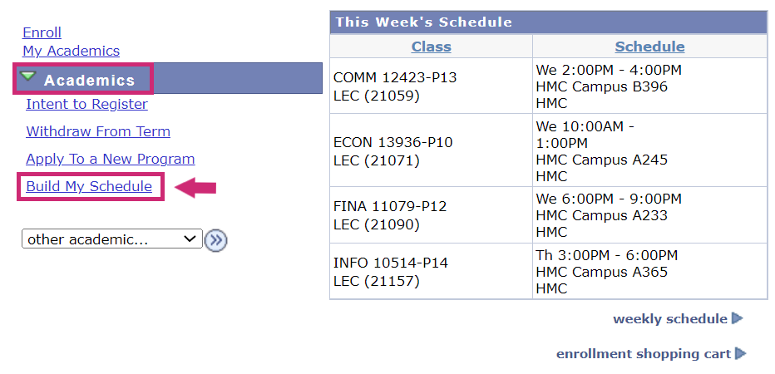
Visit myStudent Centre to determine if you have access to the Build My Schedule link.

Slide 7
If you do NOT have access to Build My Schedule link, please use Enrolment Shopping Cart and follow instructions to add/swap/drop courses.

Slide 8
Edit Your Schedule
Once you have paid your fees you can log on to myStudent Centre to:
Add courses
Drop courses
Swap courses
(Program restrictions may apply)
Please note: It is sometimes necessary to make changes to schedules. Therefore, it is recommended that students check their schedule during the first week of classes to ensure they have the current version.

Slide 9
Add a Course via Enrolment Shopping Cart
If you do not have access to Build My Schedule, please follow these instructions.

Slide 10
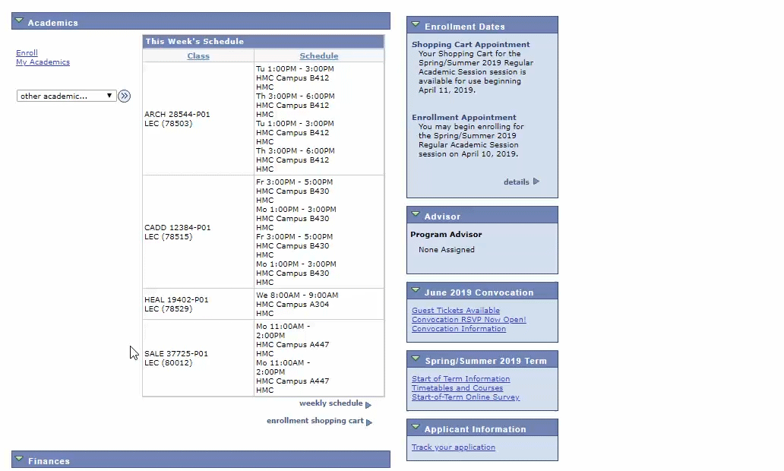
How to add a course
Step 1: Open Course Add in myStudent Centre
Select Enrolment: Add from the Academics drop down menu

Slide 11
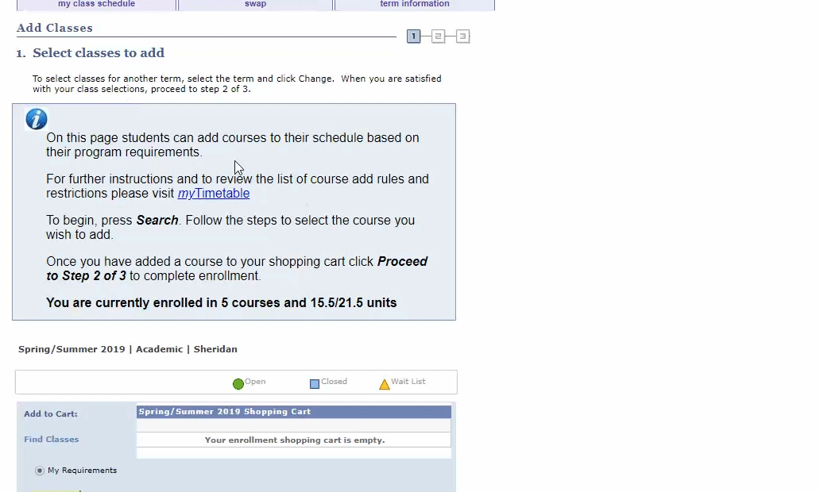
Step 2: Search for eligible classes
Click search (you will be able to find classes that meet the requirements of your program)

Slide 12
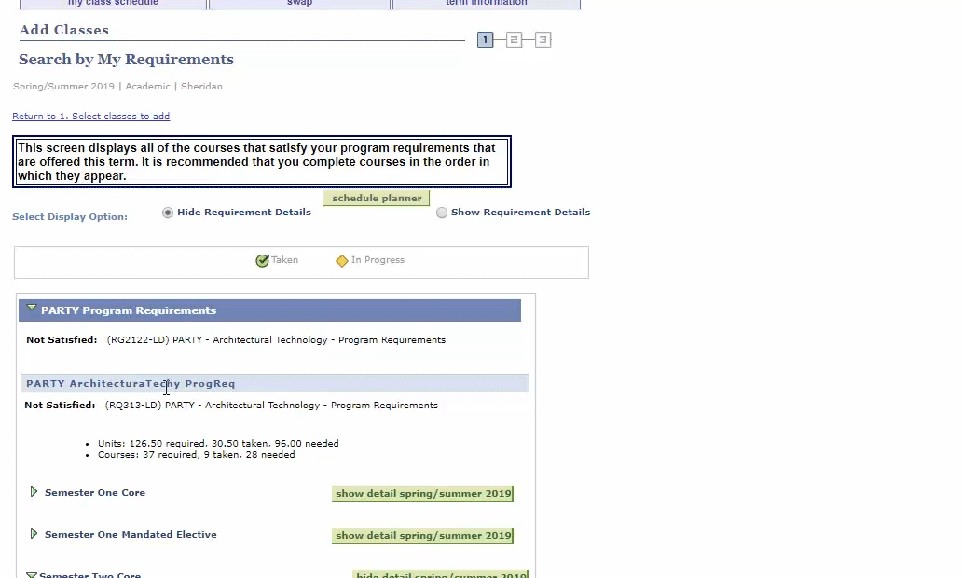
Step 3: Select the semester and the course you wish to add to your schedule.

Slide 13
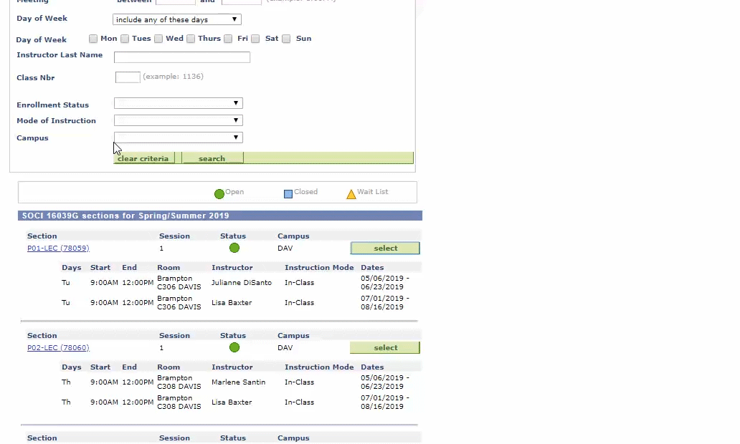
Step 4: Select class to add
Select the classes you wish to take (be sure to review the date, time and location of your class). Click the "View All" link to see additional classes. Click "Next" to confirm you wish to add the class.

Slide 14
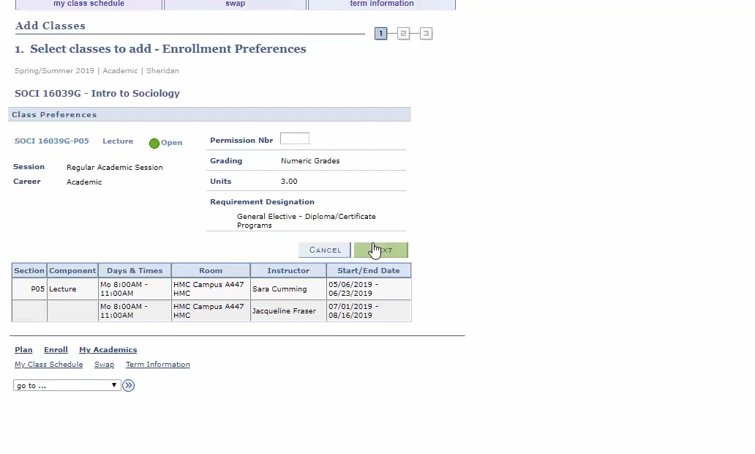
Step 5: Check classes in your Shopping Cart
Check that the class was added to your shopping cart. Click proceed to step 2 of 3. Confirm your class information is correct and select finish enrolling

Slide 15
Swap a Course via Enrolment Shopping Cart
If you do not have access to Build My Schedule, please follow these instructions.

Slide 16
Swap Restrictions
Students are not able to swap classes in all instances. Please note the following:
Students cannot add a class if there is a time conflict with another class
Each student is assigned an expected course load based on their current level in their program. Students are unable to exceed this course load using the online course add functionality
Students in Chemical Programs are restricted from swapping courses

Slide 17
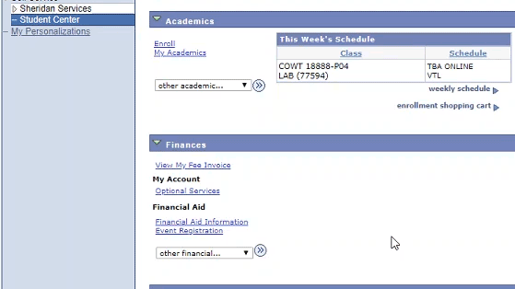
How to Swap a Course
Step 1: Open Course Swap in myStudent Centre
Select Enrolment: Swap from the Academics drop down menu and hit the ›› button

Slide 18
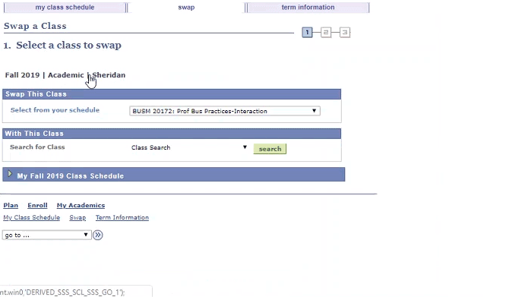
Step 2: Search for Eligible Classes
To begin select the class you wish to swap and click Search to search Sheridan's course catalogue for eligible courses.

Slide 19
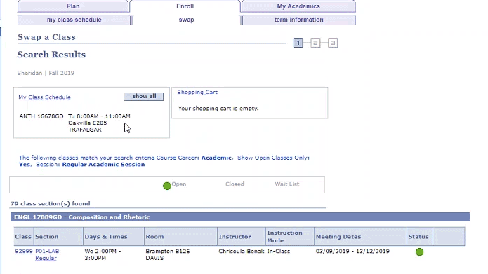
Step 3: Select Classes
Select the class you wish to swap to. If the search returns no classes, you may need to widen your search criteria or no classes with free places are currently available.
Click the "View All" link to see additional classes.
Click Next when prompted to proceed with your swap.

Slide 20
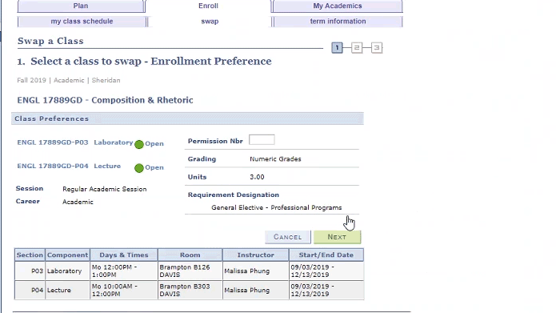
Step 4: View detailed class information
Review the class time and location and click "Next" to continue.
Lecture/Lab courses
When swapping a class with a lab component you will be prompted on a new screen to select the lecture/lab component that coincides with the class you chose to swap to. Select this component and click "Next" to continue swapping.

Slide 21
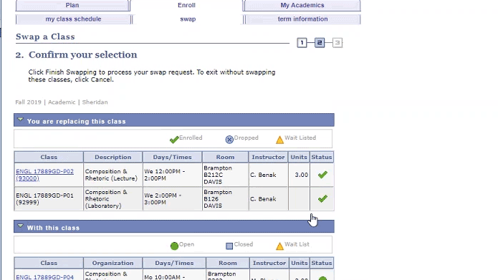
Step 5: Confirm your swap selection
After reviewing the class information, click Finish Swapping to confirm your swap selection.

Slide 22
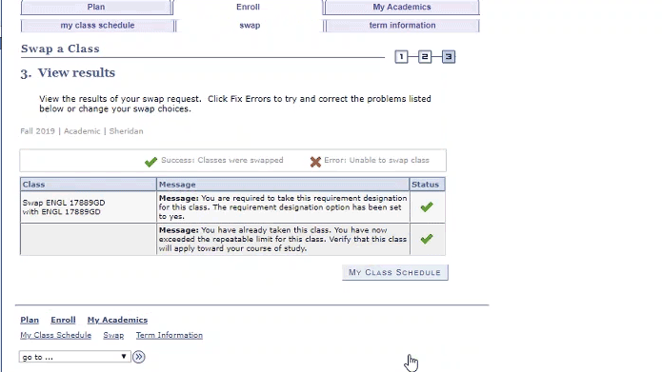
Step 6: View the result of swap request

Slide 23
Choose Your Elective
Depending on your program, you will either enrol in a General Elective, a Program Elective or a Breadth Elective.
Elective places are limited and assigned on a first come, first served basis - so it is strongly recommended that you enrol in your elective as soon as possible.
Once cross-campus enrolment opens, more options may become available to you. However, it's recommended that you select an elective as soon as possible in case your preferred option isn't available.

Slide 24
Electives - For assigned schedule students
If you will be issued a schedule, you may continue to swap your placeholder for an elective
Breadth electives are NOT associated with any single campus. This means that when you click on your Breadth elective placeholder, you will now see breadth electives available across ALL campuses, regardless of which time block you're associated with. This will allow you to freely swap your placeholder with an elective from another campus.
General Education electives ARE NOT associated with specific dates or time blocks. The placeholder sits at the bottom of your schedule, and when you click on the placeholder, you'll be able to see ALL offerings at your HOME CAMPUS only, regardless of the date and time. This will allow you to freely select an elective.

Slide 25
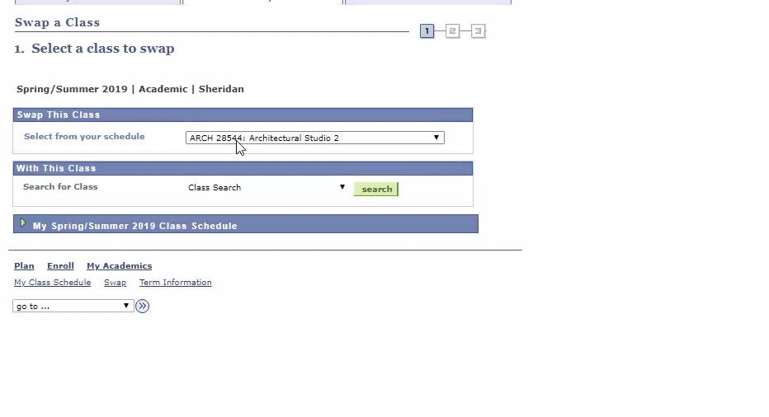
Electives Placeholder
If you are required to take an elective, an elective placeholder will be on your schedule. You need to swap each placeholder with a course. Select the class you wish to swap from the dropdown menu.

Slide 26
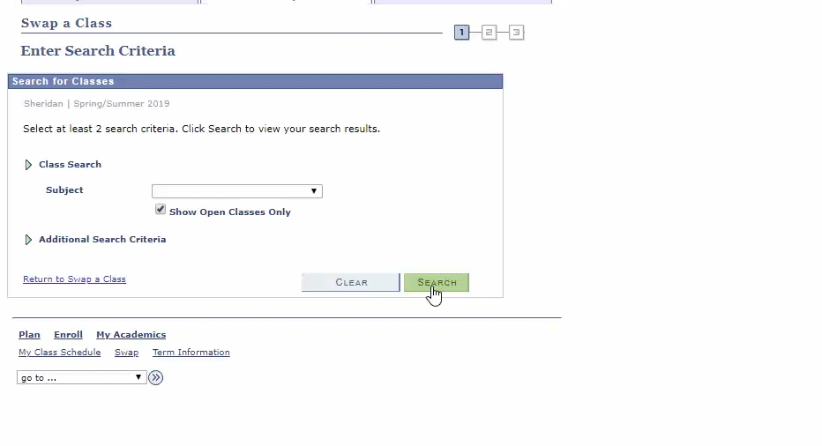
This will bring you to the Search Criteria page – DO NOT ENTER ANY VALUES ON THIS SCREEN. Click the "Search" button to generate your list of electives. Review your elective options and click the "Select" button next to the class you want.

Slide 27
To complete your enrolment, click the “Finish Swapping” button at the bottom of the page.

Slide 28
How to Re-add a Dropped Elective
If you have an assigned schedule and you have dropped your elective and/or placeholder, don't worry! You can add a new elective using the enrolment shopping cart.
If your Program is exempt from Add, you may visit your campus Service Hub or email registration@sheridancollege.ca

Slide 29
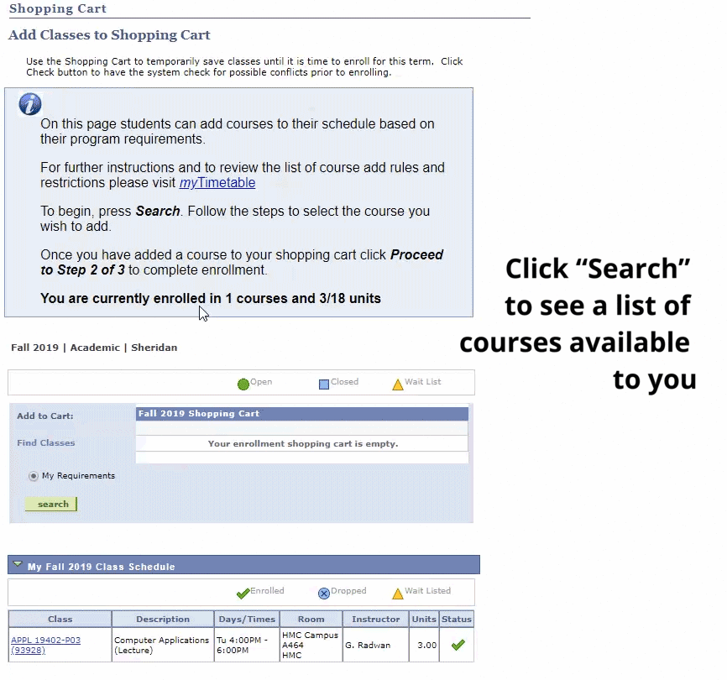

Slide 30
Drop a Course via Enrolment Shopping Cart
If you do not have access to Build My Schedule, please follow these instructions.

Slide 31
How to Drop a Course
Step 1: Open Course Drop in myStudent Centre Select Enrolment: Drop from the Academics drop down menu and hit the ›› button
Step 2: Select class to drop To begin, select the classes you wish to drop and click "Drop Selected Classes". If you are unsure, please contact your Program Advisor before dropping a class.
Step: 3 Confirm drop On the next screen you will be asked to confirm the drop.
Step 4: Review drop confirmation You will receive confirmation if your Drop has been successful or not.

Slide 32
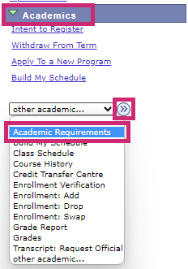
Confirm your Academic Requirements in myStudent Centre
Log in to myStudent Centre.
2.Under the Academics section, open the dropdown menu and select Academic Requirements, then click (≫).

Slide 33
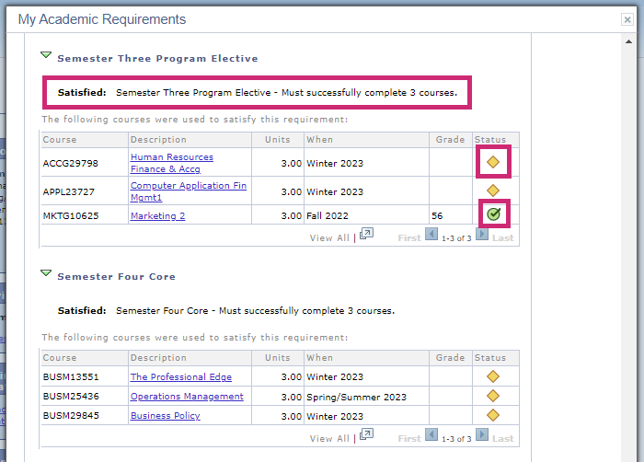
Ensure that you have selected the electives necessary to satisfy your program requirements. The yellow diamond indicates In Progress and the green check mark indicates Taken.

Slide 34
Finding Your Classes
It's especially important to become familiar with the location of your classes, as some may not located on your home campus.

Slide 35
If you see a room number in your schedule, it means that you have a face-to-face class on campus.
If you see Virtual Campus Remote, it means that you have a virtual (remote) class.

Slide 36
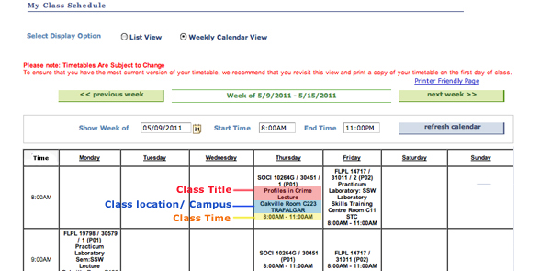
The visual below will help you to understand your schedule:

Slide 37
Delivery Modes
In-Person: All courses are on campus and students must attend in person.
Remote: All courses are delivered virtually; no in-person components.
Hybrid: Students will have a combination of In-Person and Remote course sections. Some of the in-person portions/courses must be attended on campus and are mandatory.

Slide 38
SLATE – slate.sheridancollege.ca
Log into SLATE to view course info and materials and see how your course is being delivered (remotely, synchronously, asynchronously).
If you swap, drop or add a course it may take 1-2 days to appear in SLATE. Be sure to first check that the course appears in your schedule in myStudent Centre.
If the course appears in your schedule in myStudent centre but is not accessible on SLATE after 2 business days, please inquire with your course instructor.

Slide 39
The system won't allow me to enrol in the class I want. Why?
There are a few different reasons why you may not be able to select a class:
Exclusions: Some of our GenEd classes overlap with the required classes in some Sheridan programs. If a GenEd class repeats program content, then students cannot enroll in that particular class since GenEd classes need to introduce students to ideas and concepts outside of their program.
Reserve Capacity: Some GenEd classes are reserved for specific program areas and may not be open to all students.
After Day 10: Students cannot enroll online after Day 10 of the new semester. If you still need a GenEd after Day 10, you will need to see your Records Specialist in the Office of the Registrar.

Slide 40
Full Enrollment
Once a class is full, you can monitor the class enrollment to see if a space opens up, but make sure that you enroll in another class in the meantime. Many of the GenEd courses fill quickly, so register early to give yourself the most options to pick from!

Slide 41
In-person service hub
Sheridan's In-Person Service Hub
If you’ve got questions, we’ve got answers! Each campus has experienced staff to help you at the Service Hub! Let us help you with your schedule and course registration, admissions, finances, academic requirements, graduation, and more!
Hours of Operation:
Monday - Friday 8:30am - 4:30pm
TRAFALGAR | DAVIS | HMC
A134a (Near Tim Hortons) | B-Wing, Main Entrance area (In front of the Centre for Student Success, Rm. B230) | A-Wing, Main Entrance area (In front of Rm. A147)

