Slide 1

TIPS FOR ENROLLING IN OPEN COURSES
The system won't allow me to enrol in the class I want. Why?

Slide 2
The system won't allow me to enrol in the elective I want. Why?
There are a few different reasons why you may not be able to select a class:
Exclusions: Some of our GenEd classes overlap with the required classes in some Sheridan programs. If a GenEd class repeats program content, then students cannot enroll in that particular class since GenEd classes need to introduce students to ideas and concepts outside of their program.
Full Enrollment: GenEd classes are limited to 40 students.
Reserve Capacity: Some GenEd classes are reserved for specific program areas and may not be open to all students.
After Day 10: Students cannot enroll online after Day 10 of the new semester. If you still need a GenEd after Day 10, you will need to see your Records Specialist in the Office of the Registrar.

Slide 3
The system gives me an error message and won’t allow me to enrol. Why?
Class is Full
Time Conflicts
Maximum Load Exceeded
Financial Hold
No Study Permit Hold
Not Enrolled in Term
Lecture/Lab Courses

Slide 4
ERROR: The class you want is full
Once a class is full, you can monitor the class enrollment to see if a space opens up, but make sure that you enroll in another class in the meantime. Many of the GenEd courses fill quickly, so register early to give yourself the most options to pick from.

Slide 5
ERROR: Time conflict
You may need to edit your schedule to resolve time conflicts. Classes cannot overlap.
Be sure to account for adequate travel time between classes if you have a hybrid schedule of virtual and in-person classes; or a cross-campus schedule.
Students can swap a class for the same class at a different time or day.
Search for other class sections to swap to that fit your schedule. If the search returns no classes, you may need to widen your search criteria or no classes with free places are currently available. Click the "View All" link in enrollment shopping cart to see additional classes.

Slide 6
ERROR: Maximum load exceeded
All full-time, postsecondary students may take additional courses in conjunction with their regular curriculum at Sheridan, providing they meet course prerequisites and satisfy any co-requisites concurrently:
Students may take additional courses beyond their full course load, if there is space available. Additional fees will apply.
If you are taking a course for a future term, you will still be charged full-time fees that term.
Students may replace courses for which they have been granted Advanced Standing or Prior Learning Assessment with courses of equal credit value, if space is available. These substitutions must be made within the same term; credit values/courses cannot be transferred to subsequent terms. Additional fees may apply.
EMAIL YOUR HOME CAMPUS TO INCREASE YOUR ENROLMENT LIMIT.

Slide 7
ERROR: Financial hold on account
The outstanding balance needs to be paid to access course registration.
You can make your payment at a branch of your bank or financial institution, or through your financial institution's automated, telephone or online banking services. Please use Sheridan College as the payee and your Sheridan student number as the account/reference number.
Make sure you keep a copy of your transaction reference number (for online banking) or your transaction receipt (for in-person banking).
Once Sheridan receives the payment from your financial institution, it will be confirmed in myStudentCentre.

Slide 8
ERROR: No Study Permit Hold
Proof of your study permit approval will be required for the course registration.
You may make a virtual appointment or an in- person appointment (Davis Campus, HMC Campus, Trafalgar Campus) with one of our International Student Advisors to seek additional assistance.
You can also email askanadvisor@sheridancollege.ca with your question.

Slide 9
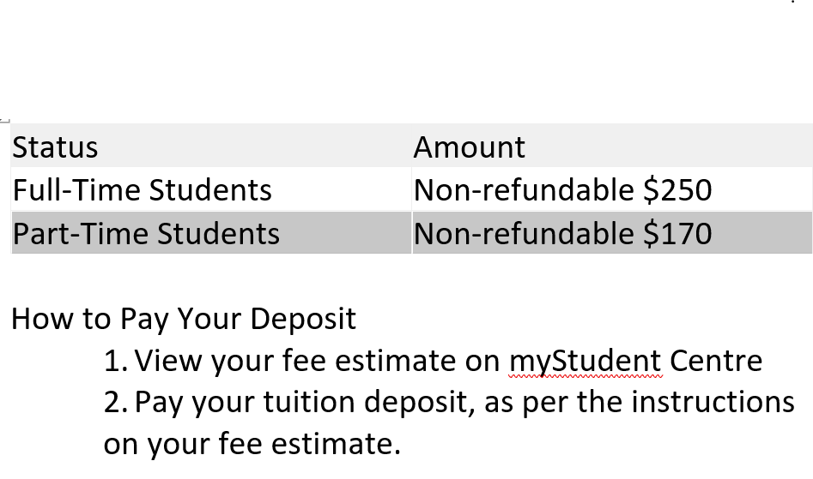
ERROR: Not Enrolled in Term
If you are a new domestic student or a returning student, you are required to pay a deposit once per academic year (Fall term).

Slide 10
ERROR: Lecture/lab courses
When swapping a class with a lab component you will be prompted to select the lecture/lab component that coincides with the class you chose to swap to.
Each lecture is assigned with a specific lab component. You cannot mix and match lecture and lab sections and must select from the set pairings.

Slide 11
Frequently Asked Questions
General education electives

Slide 12
Choosing your Electives
Once your enrolment appointment opens, you can choose your elective for the term. The earlier you select your elective, the more options will be available to you.
You will choose your course electives using myStudent Centre.
Depending on your program, you will either enrol in a General Education Elective, a Program Elective or a Breadth Elective.
Elective places are limited and assigned on a first come, first served basis - so it is strongly recommended that you enrol in your elective as soon as possible.

Slide 13
My schedule has a course called GENLELECT1. What does this mean?
This is a reminder that you need to select a General Education course for your upcoming semester. The time listed in the placeholder is the time your core program has recommended for your schedule.

Slide 14
When can I register for my GenEd?
Online, Self-enrollment for the GenEd classes begins four to six weeks before the new semester starts and lasts till Day 10 of the new semester.
If you don't register before Day 10, you will need to make an appointment with your Records Specialist in the Office of the Registrar who can enroll you in an available class or discuss other options.

Slide 15
Why can't I see all of the course options in myStudent Centre?
For the first few days of enrollment, you may notice that you are limited to a particular time, day, and/or campus. This is to make sure that everyone has access to a class during the time that the program has recommended. However, when cross-campus enrollment opens, all GenEd time/location restrictions are removed and you will have increased access to GenEd courses that still have seats available.

Slide 16
What if I missed or was unsuccessful in my GenEd course?
You can pick up a GenEd course in a future semester. Keep in mind there is a fee associated with taking a GenEd outside of your regular program map.
Each student is assigned an expected course load based on their current level in their program. Students are unable to exceed this course load using the online course ‘add’ functionality
Current students may email their home campus to request to request additional course registration: registration@sheridancollege.ca

Slide 17
Why can’t I see my elective on my timetable after I added it?
ONLINE classes (asynchronous)
Look at the bottom of your weekly schedule. Online courses do not have a scheduled class meeting time and do not appear in time blocks.
Compressed Courses
These are 7-week courses. Be sure to refer to the correct date in your weekly schedule to view compressed courses. 7A courses start week of January 8th and 7B courses start week of March 9th.

Slide 18
PROGRAMS WITH ADD/SWAP RESTRICTIONS
All FAST students (Faculty of Applied Science and Technology) cannot edit their schedule in Year 1, Semester 1. No swapping allowed.
ECE (Early Childhood Education) students cannot edit their schedule in Year 1, Semester 1. No swapping allowed.
Students in Chemical Programs are restricted from swapping courses.
(PCETY, PCETE, PCLTN, PENST, PENCT -No swapping permitted at all for any level and for any reason).

Slide 19
Communication Skills Course
Based on your Grade 12 or postsecondary English score, or the English Language Proficiency score in your application, you will be placed in Communication Foundations (COMM 19997) or Essential Communication Skills (COMM 19999) in your first semester.
You will be notified by email regarding your communication course placement.
You may challenge your placement in Communication Foundations (COMM 19997) by writing a challenge exam, provided there is adequate time to write and assess the exam prior to the start of the term. Please contact Karen Agaton to see if you qualify.

Slide 20
See the following definitions of the different delivery modes:
In-Person: All courses are on campus and students must attend in person.
Remote: All courses are delivered virtually; no in-person components.
Hybrid: Students will have a combination of In-Person and Remote course sections. Some of the in-person portions/courses must be attended on campus and are mandatory.

Slide 21
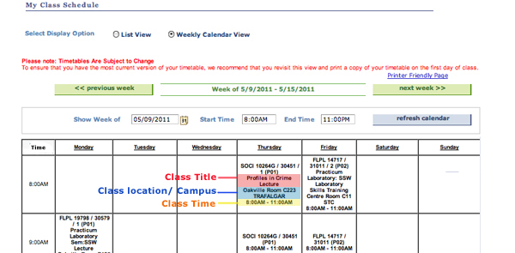
The visual below will help you to understand your schedule:

Slide 22

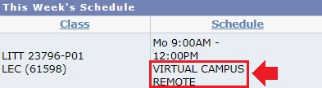
Course delivery details are available in your schedule posted to myStudent Centre:
If you see a room number in your schedule, it means that you have a face to face class on campus.
If you see Virtual Campus Remote, it means that you have a virtual (remote) class.

Slide 23
Check Your Academic Requirements
Check your Academic Requirements report before creating or editing your schedule. This will make sure you're on track to satisfy your Program Requirements and graduate as well as speeding up the enrolment process.

Slide 24
Add a Course
Deadlines to Add a Course:
Regular Session & Session A: January 19, 2024
Who can add a course?
Postsecondary full-time and part-time students are able to add courses and may do so prior to their normal program progression.
Important: Students are also able to add courses ahead of their normal program progression. However, students are advised to keep to the recommended program path as outlined in myAcademic Requirements.

Slide 25
SLATE – slate.sheridancollege.ca
Log into SLATE to view course info and materials and see how your course is being delivered (remotely, synchronously, asynchronously).
If you swap, drop or add a course it may take 1-2 days to appear in SLATE. Be sure to first check that the course appears in your schedule in myStudent Centre.
If the course appears in your schedule in myStudent centre but is not accessible on SLATE after 2 business days, please inquire with your course instructor.

Slide 26
In-person Service Hub
Sheridan's In-Person Service Hub
If you’ve got questions, we’ve got answers! Each campus has experienced staff to help you at the Service Hub! Let us help you with your schedule and course registration, admissions, finances, academic requirements, graduation, and more!
Hours of Operation:
Monday - Friday
8:30am - 4:30pm
TRAFALGAR | DAVIS | HMC
A134a (Near Tim Hortons) | B-Wing, Main Entrance area (In front of the Centre for Student Success, Rm. B230) | A-Wing, Main Entrance area (In front of Rm. A147)

